Slide 1
Tutorial 2
Computer Animation 2023 Spring

Slide 2
Solve the system
Compute the result of the model

Slide 3


Explicit Euler
$$q_{n+1}=q_{n}+hv_{n}$$
$$v_{n+1}=v_{n}+hM^{−1}f\left(q_{n}\right)$$
Position
Velocity
$$Δt$$
Total force
Mass matrix
It is extremely unstable for cloth simulation

Slide 4

Semi-Implicit Euler
$$q_{n+1}=q_{n}+hv_{n+1}$$
$$v_{n+1}=v_{n}+hM^{−1}f\left(q_{n}\right)$$
Position
Velocity
$$Δt$$
Total force
Mass matrix
Need small time step to keep stable
~0.002 in our case

Slide 5

Implicit Euler
$$q_{n+1}=q_{n}+hv_{n+1}$$
$$v_{n+1}=v_{n}+hM^{−1}f\left(q_{n+1}\right)$$
$$f\left(q_{n+1}\right)≈f\left(q_{n}\right)+{\left(∇f\right|}_{q_{n}})\left(q_{n+1}−q_{n}\right)$$
It is too slow
Baraff, David, and Andrew Witkin. "Large steps in cloth simulation." Proceedings of the 25th annual conference on Computer graphics and interactive techniques. 1998.

Slide 6



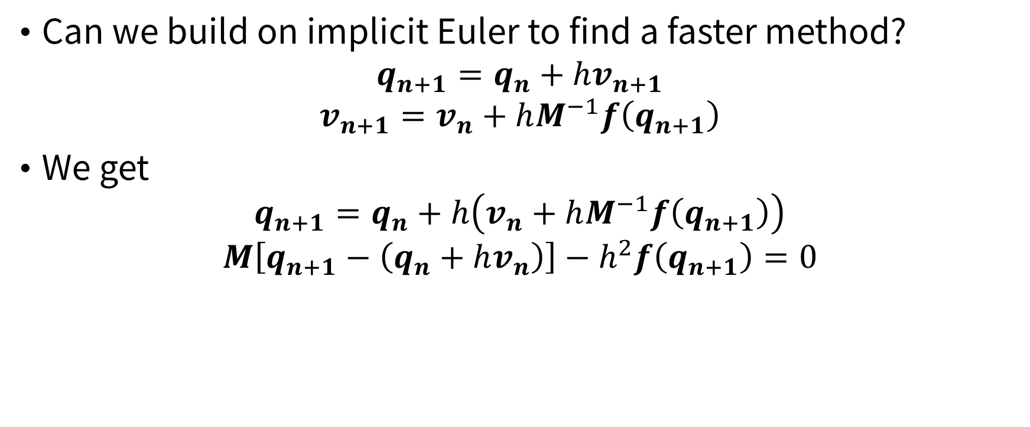
A faster approach: formulation
Can we build on implicit Euler to find a faster method?
$$q_{n+1}=q_{n}+hv_{n+1}$$
$$v_{n+1}=v_{n}+hM^{−1}f\left(q_{n+1}\right)$$
We get
$$q_{n+1}=q_{n}+h\left(v_{n}+hM^{−1}f\left(q_{n+1}\right)\right)$$
$$M\left[q_{n+1}−\left(q_{n}+hv_{n}\right)\right]−h^{2}f\left(q_{n+1}\right)=0$$
$$x$$
$$y$$
$$x$$
Liu, Tiantian, et al. "Fast simulation of mass-spring systems." ACM Transactions on Graphics (TOG) 32.6 (2013): 1-7.

Slide 7
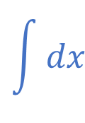

A faster approach: formulation
$$M\left[x−y\right]−h^{2}f\left(x\right)=0$$
$$M\left[x−y\right]−h^{2}f_{int}\left(x\right)−h^{2}f_{ext}=0$$
$$g\left(x\right)=\frac{1}{2}{\left(x−y\right)}^{T}M\left(x−y\right)+h^{2}E_{int}\left(x\right)−h^{2}x^{T}f_{ext}$$
Find $x^{∗}=\underset{x}{argmin}{g(x)}$
Derived from potential energy
Constant like gravity or penalty force
$$\int{dx}$$

Slide 8
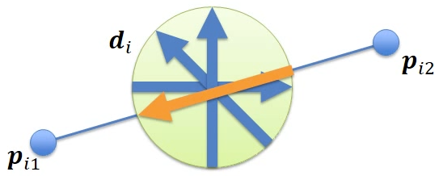
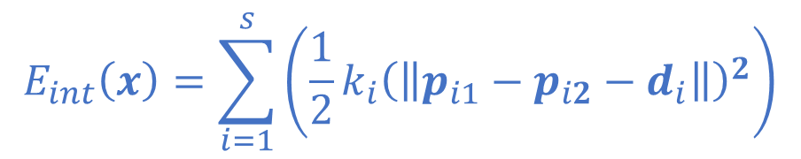
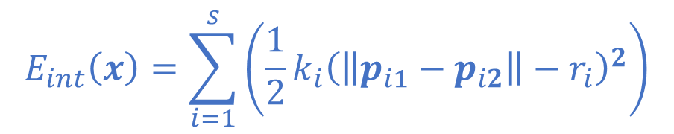

A faster approach: formulation
$$g\left(x\right)=\frac{1}{2}{\left(x−y\right)}^{T}M\left(x−y\right)+h^{2}E_{int}\left(x\right)−h^{2}x^{T}f_{ext}$$
Convex quadratic function
Linear function
$$E_{int}\left(x\right)=\sum_{i=1}^{s}{\left(\frac{1}{2}k_{i}{\left(\left\|\left.p_{i1}−p_{i2}\right\|\right.−r_{i}\right)}^{2}\right)}$$
$$E_{int}\left(x\right)=\sum_{i=1}^{s}{\left(\frac{1}{2}k_{i}{\left(\left\|\left.p_{i1}−p_{i2}−d_{i}\right\|\right.\right)}^{2}\right)}$$

Slide 9
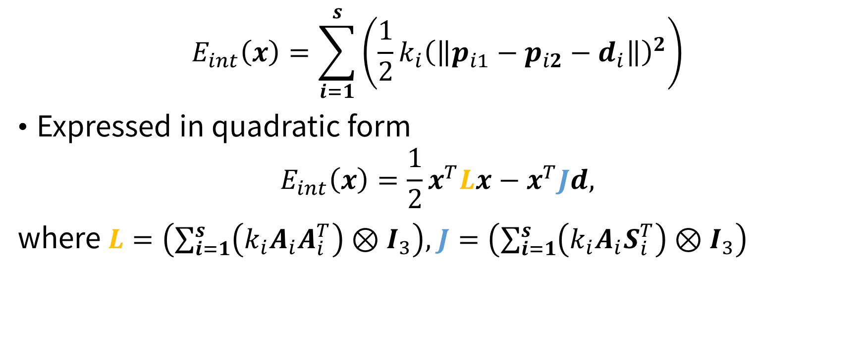
A faster approach: formulation
$$E_{int}\left(x\right)=\sum_{i=1}^{s}{\left(\frac{1}{2}k_{i}{\left(\left\|\left.p_{i1}−p_{i2}−d_{i}\right\|\right.\right)}^{2}\right)}$$
Expressed in quadratic form
$$E_{int}\left(x\right)=\frac{1}{2}x^{T}Lx−x^{T}Jd,$$
where $L=\left(\sum_{i=1}^{s}{\left(k_{i}A_{i}A_{i}^{T}\right)}⊗I_{3}\right),$ $J=\left(\sum_{i=1}^{s}{\left(k_{i}A_{i}S_{i}^{T}\right)}⊗I_{3}\right)$

Slide 10
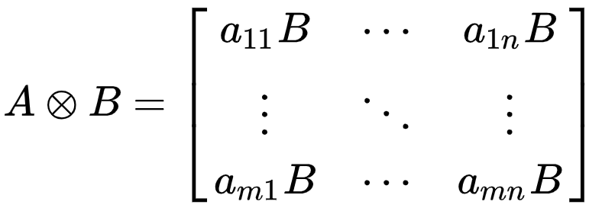
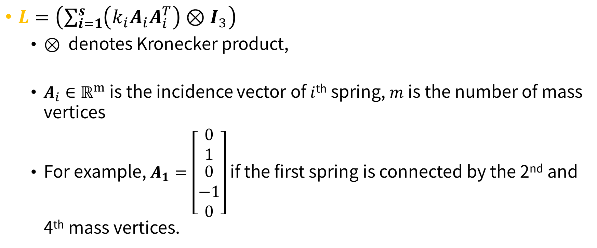
A faster approach: formulation
$L=\left(\sum_{i=1}^{s}{\left(k_{i}A_{i}A_{i}^{T}\right)}⊗I_{3}\right)$
$⊗$ denotes Kronecker product,
$A_{i}∈ℝ^{m}$ is the incidence vector of $i$^{th} spring, $m$ is the number of mass vertices
For example, $A_{1}=\left[\begin{matrix}0 \\ 1 \\ \begin{matrix}0 \\ −1 \\ 0\end{matrix}\end{matrix}\right]$ if the first spring is connected by the 2nd and 4th mass vertices.

Slide 11

A faster approach: formulation
$J=\left(\sum_{i=1}^{s}{\left(k_{i}A_{i}S_{i}^{T}\right)}⊗I_{3}\right)$
$S_{i}∈ℝ^{s}$ is the spring indicator of $i$^{th} spring, $s$ is the number of springs
For example, $S_{1}=\left[\begin{matrix}1 \\ 0 \\ 0\end{matrix}\right]$, $S_{2}=\left[\begin{matrix}0 \\ 1 \\ 0\end{matrix}\right]$, $S_{3}=\left[\begin{matrix}0 \\ 0 \\ 1\end{matrix}\right]$

Slide 12
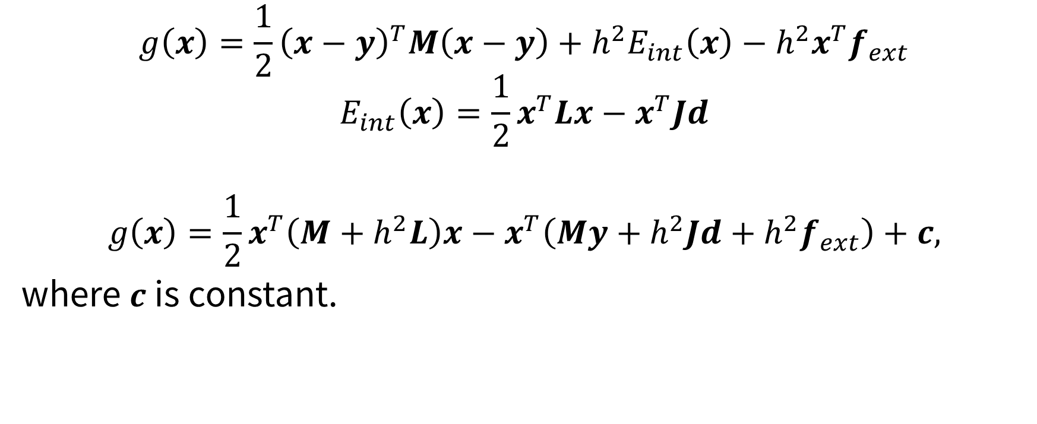
A faster approach: formulation
$$g\left(x\right)=\frac{1}{2}{\left(x−y\right)}^{T}M\left(x−y\right)+h^{2}E_{int}\left(x\right)−h^{2}x^{T}f_{ext}$$
$$E_{int}\left(x\right)=\frac{1}{2}x^{T}Lx−x^{T}Jd$$
$$g\left(x\right)=\frac{1}{2}x^{T}\left(M+h^{2}L\right)x−x^{T}\left(My+h^{2}Jd+h^{2}f_{ext}\right)+c,$$
where $c$ is constant.

Slide 13

A faster approach: formulation
$$\min_{x∈ℝ^{3m}, d∈U}{g\left(x\right)=\frac{1}{2}x^{T}\left(M+h^{2}L\right)x−x^{T}\left(My+h^{2}Jd+h^{2}f_{ext}\right)+c},$$
where $U=\{\left(d_{1},…,d_{s}\right)∈ℝ^{3s}:\left\|d_{i}\right\|=r_{i}\}$

Slide 14
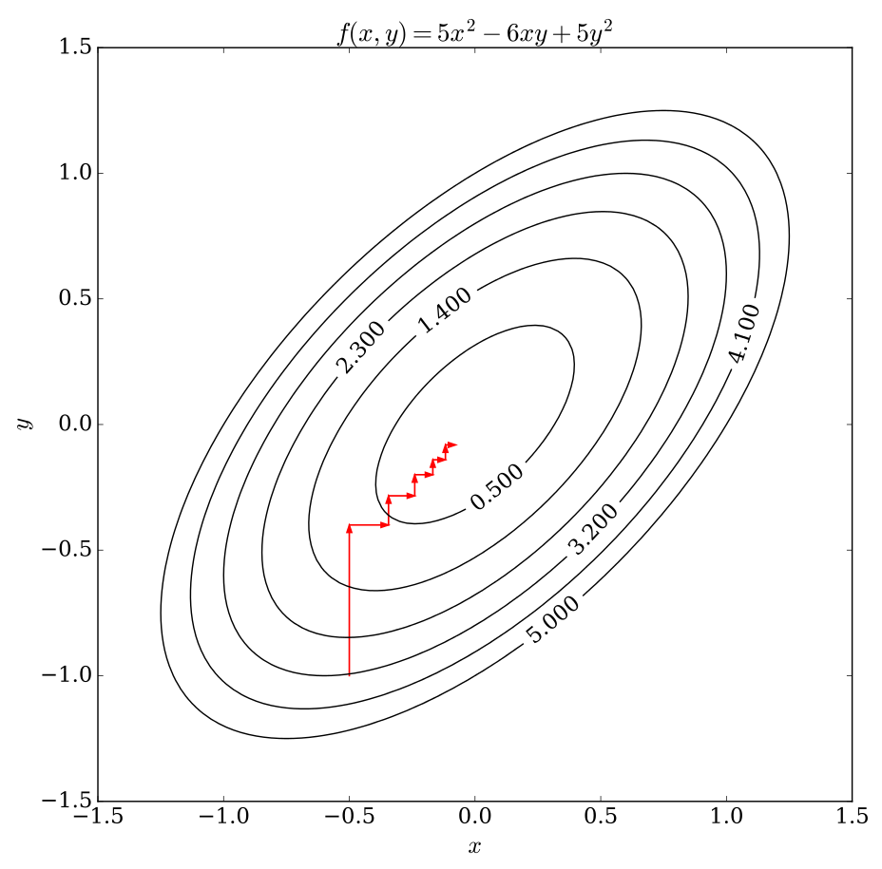
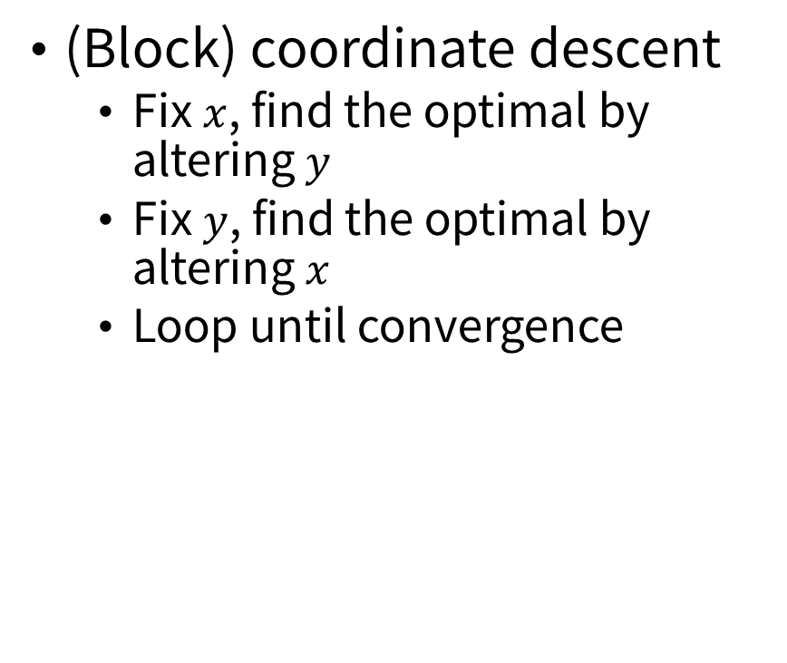
A faster approach: numerical solution
(Block) coordinate descent
Fix $x$, find the optimal by altering $y$
Fix $y$, find the optimal by altering $x$
Loop until convergence

Slide 15
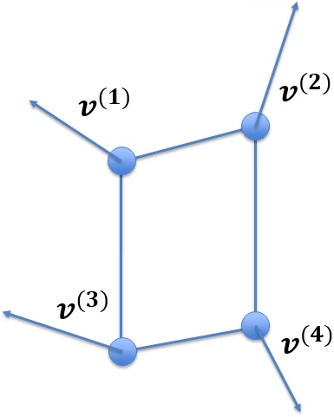
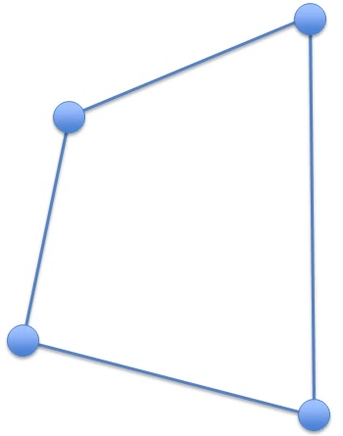

A faster approach: numerical solution
$$\min_{x∈ℝ^{3m}, d∈U}{g\left(x\right)=\frac{1}{2}x^{T}\left(M+h^{2}L\right)x−x^{T}\left(My+h^{2}Jd+h^{2}f_{ext}\right)+c}$$
Initial guess: $x≔y=q_{n}+hv_{n}$

Slide 16
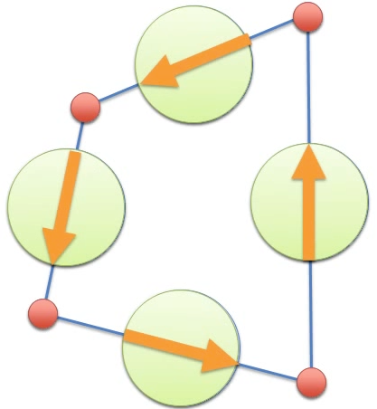
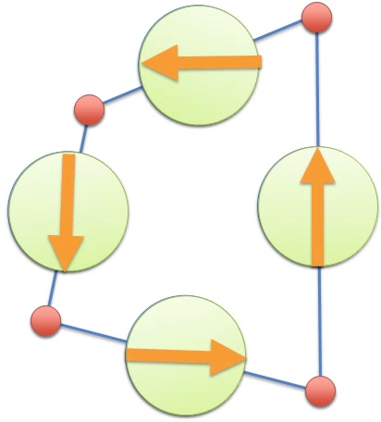

A faster approach: numerical solution
$$\min_{x∈ℝ^{3m}, d∈U}{g\left(x\right)=\frac{1}{2}x^{T}\left(M+h^{2}L\right)x−x^{T}\left(My+h^{2}Jd+h^{2}f_{ext}\right)+c}$$
Initial guess: $x≔y=q_{n}+hv_{n}$
Fix $x$, find optimal by altering $d$
(local step)

Slide 17
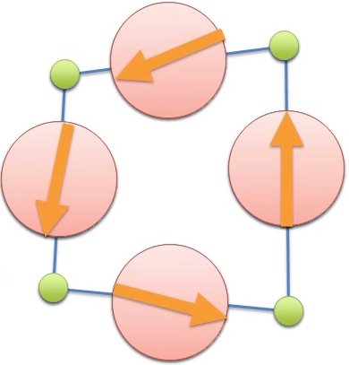
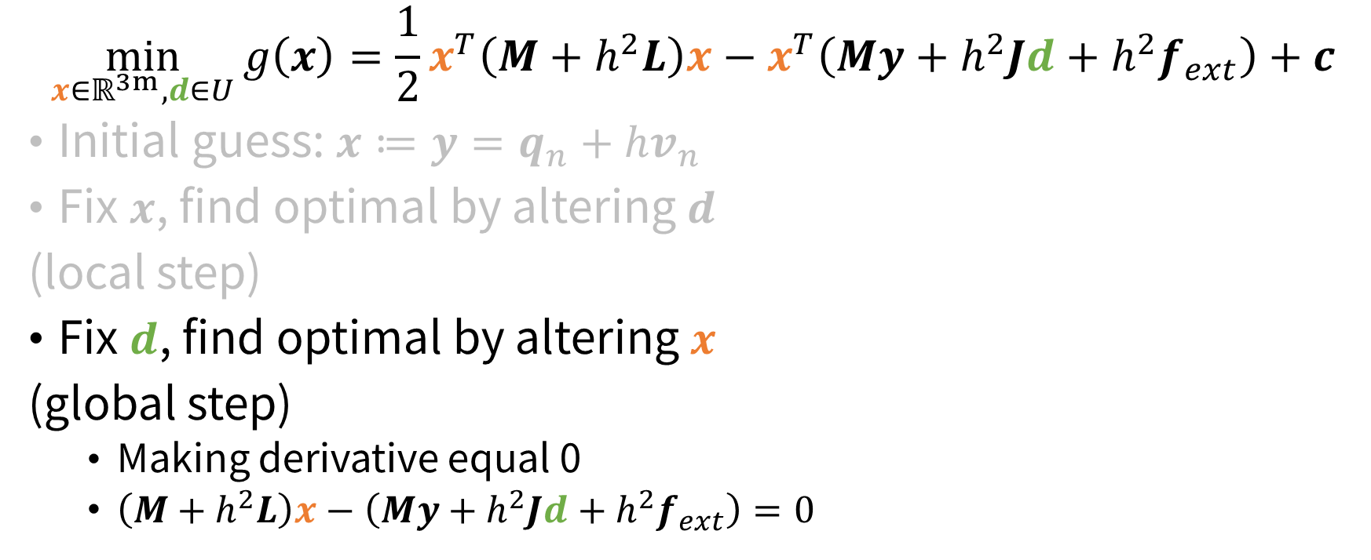
A faster approach: numerical solution
$$\min_{x∈ℝ^{3m}, d∈U}{g\left(x\right)=\frac{1}{2}x^{T}\left(M+h^{2}L\right)x−x^{T}\left(My+h^{2}Jd+h^{2}f_{ext}\right)+c}$$
Initial guess: $x≔y=q_{n}+hv_{n}$
Fix $x$, find optimal by altering $d$
(local step)
Fix $d$, find optimal by altering $x$
(global step)
Making derivative equal 0
$\left(M+h^{2}L\right)x−\left(My+h^{2}Jd+h^{2}f_{ext}\right)=0$

Slide 18
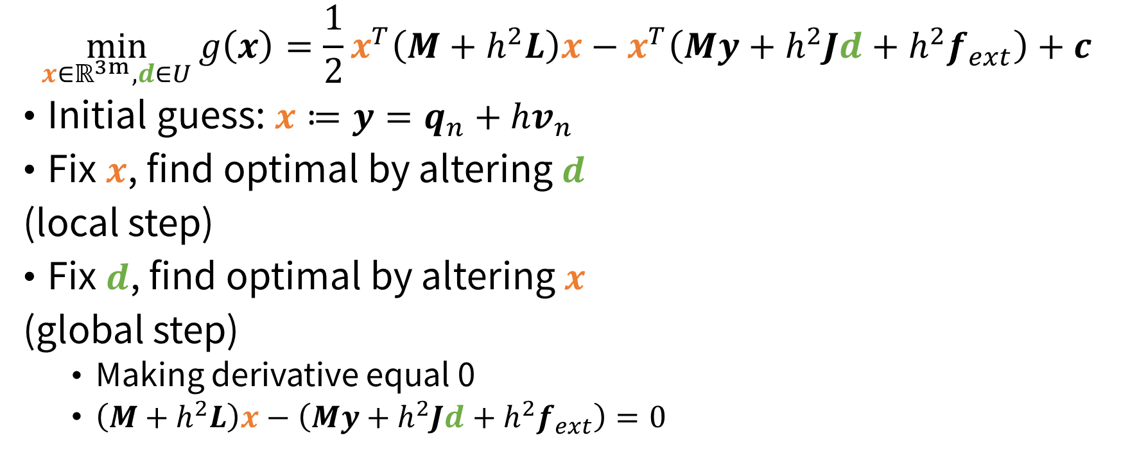
A faster approach: numerical solution
$$\min_{x∈ℝ^{3m}, d∈U}{g\left(x\right)=\frac{1}{2}x^{T}\left(M+h^{2}L\right)x−x^{T}\left(My+h^{2}Jd+h^{2}f_{ext}\right)+c}$$
Initial guess: $x≔y=q_{n}+hv_{n}$
Fix $x$, find optimal by altering $d$
(local step)
Fix $d$, find optimal by altering $x$
(global step)
Making derivative equal 0
$\left(M+h^{2}L\right)x−\left(My+h^{2}Jd+h^{2}f_{ext}\right)=0$
Loop until convergence or exceeding time limit

Slide 19
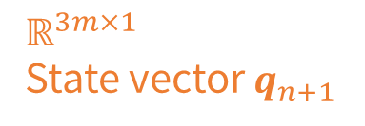


A faster approach: numerical solution
$$\left(M+h^{2}L\right)x−\left(My+h^{2}Jd+h^{2}f_{ext}\right)=0$$
$$\left(M+h^{2}L\right)x=\left(My+h^{2}Jd+h^{2}f_{ext}\right)$$
$$ℝ^{3m×3m}$$
$M$: Diagonal mass matrix
$h$: time interval
$L$: Stiffness-weighted Laplacian of the mass-spring system grpah
$$ℝ^{3m×1}$$
State vector $q_{n+1}$
The LHS of the equation remain unchanged as time goes
Thus, can be pre-factorized using Cholesky factorization
The paper states that less than 10 iterations produce plausible result

Slide 20
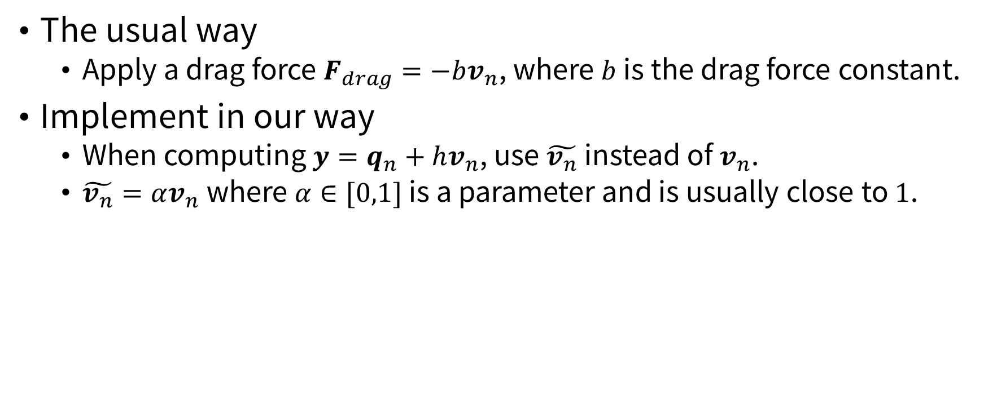
A faster approach: damping
The usual way
Apply a drag force $F_{drag}=−bv_{n}$, where $b$ is the drag force constant.
Implement in our way
When computing $y=q_{n}+hv_{n}$, use $\tilde{v_{n}}$ instead of $v_{n}$.
$\tilde{v_{n}}=αv_{n}$ where $α∈[0,1]$ is a parameter and is usually close to $1$.

Slide 21
Implementation
Let computer compute the result of the model

Slide 22
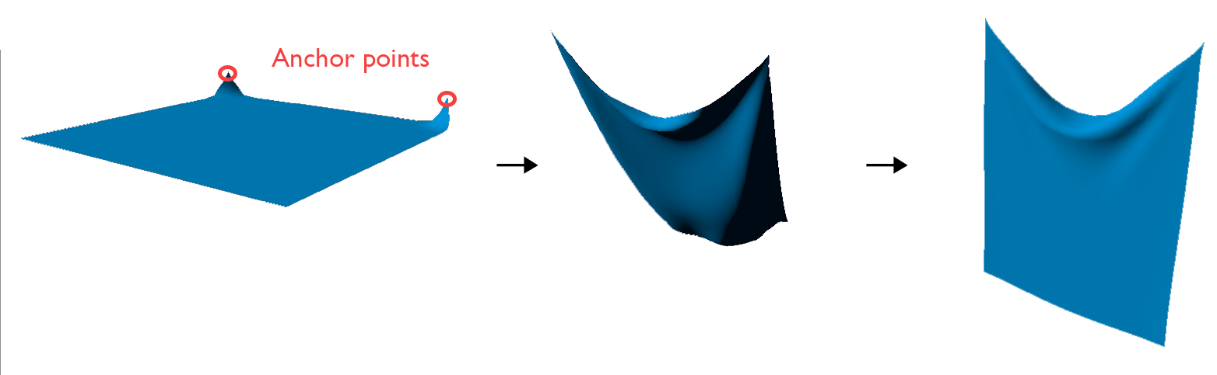
Review of our assignment

Slide 23
1. Initialization
Set parameters of the system
Resolution of the mesh (number of mass vertices)
Length and width of the cloth
Time step
Rest length of springs (uniform is easier)
Vertex mass
Damping coefficient
…

Slide 24
1. Initialization
Generate cloth mesh
Of course, the mesh needs also to be rendered
So the mesh needs to be a triangle mesh
Organize the vertices' positions and normals in std::array and pass directly to OpenGL buffer

Slide 25
1. Initialization
Construct mass-spring system
Basically a graph
Adjacency list is the preference

Slide 26

1. Initialization
Initialize solver
Construct $M$, $L$ and $J$, respectively
Cholesky factorize $M+h^{2}L$ as linear system matrix

Slide 27
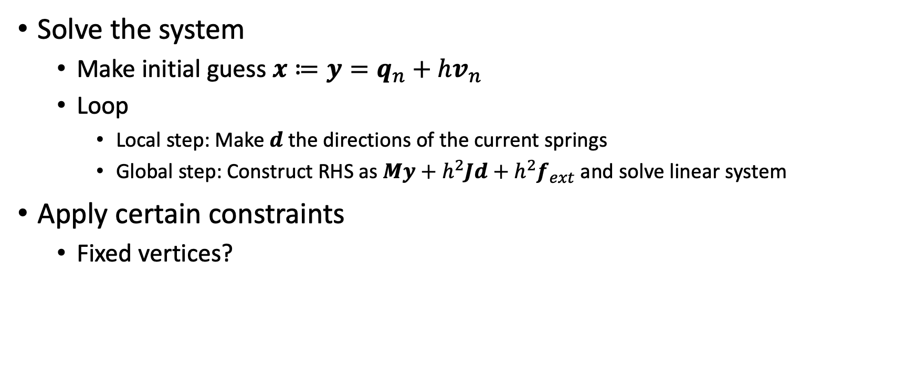

2. Main loop
Solve the system
Make initial guess $x≔y=q_{n}+hv_{n}$
Loop
Local step: Make $d$ the directions of the current springs
Global step: Construct RHS as $My+h^{2}Jd+h^{2}f_{ext}$ and solve linear system
Apply certain constraints
Fixed vertices?
How to get $v_{n}$?

Slide 28
Q & A

